Slide 1
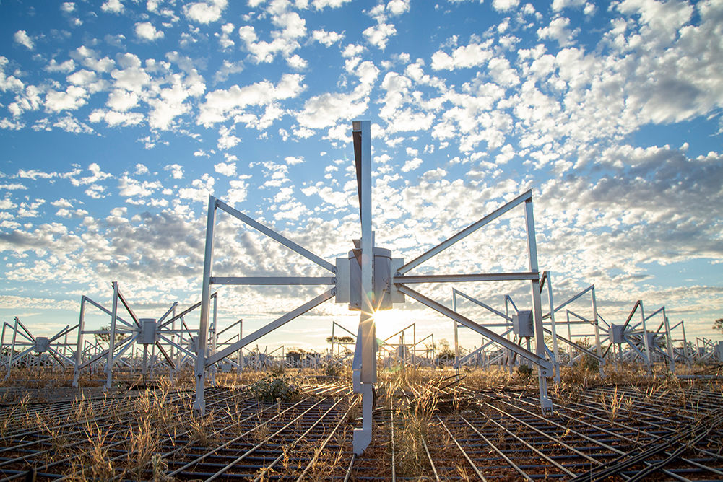
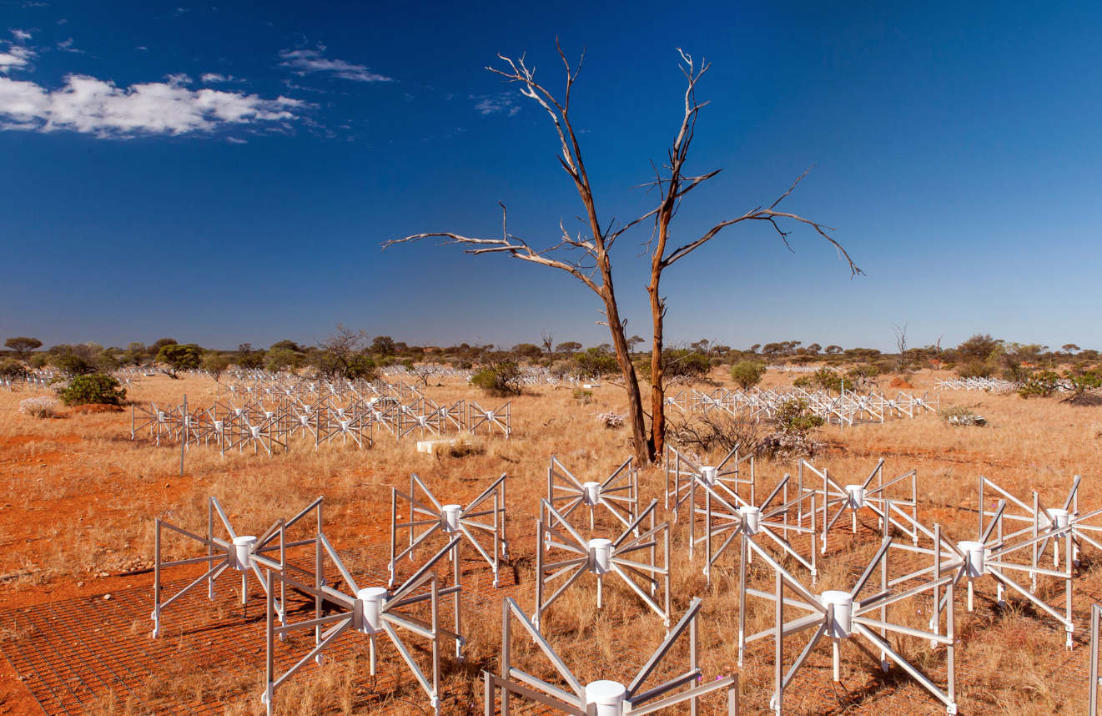
Exploring Skewness as a measure of Interplanetary Scintillation
astronomyaustralia.org.au
with the Murchinson Widefield Array IPS Survey
Saf Flatters, Data Science Student | 2025

Slide 2

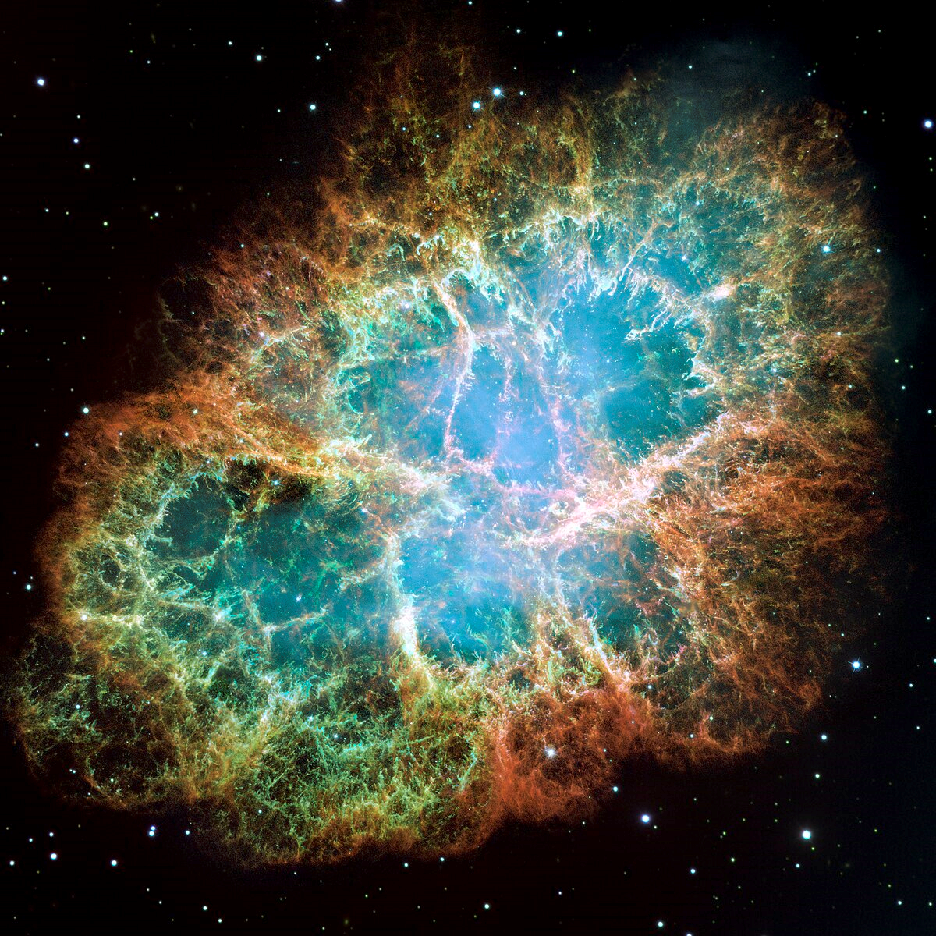
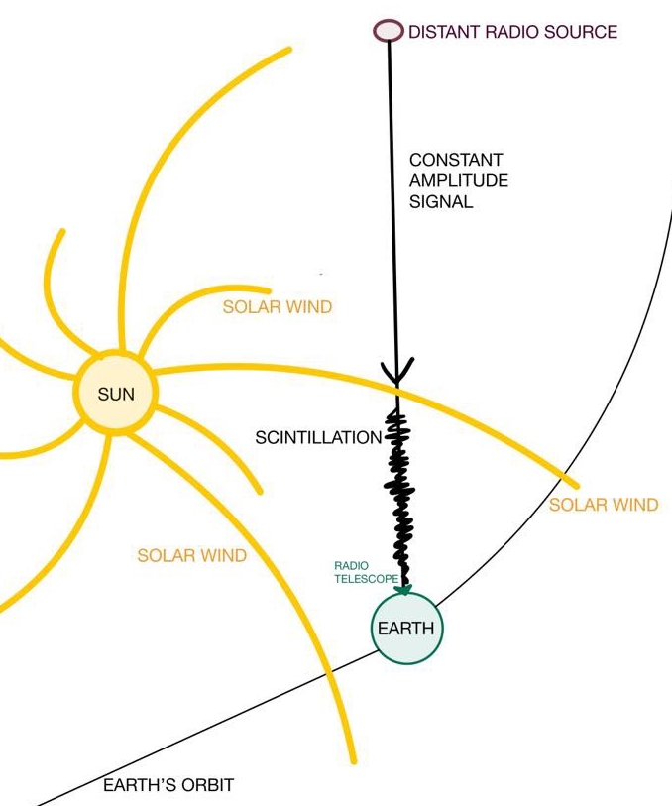
What is Interplanetary Scintillation (IPS)?
What we already know…

Slide 3
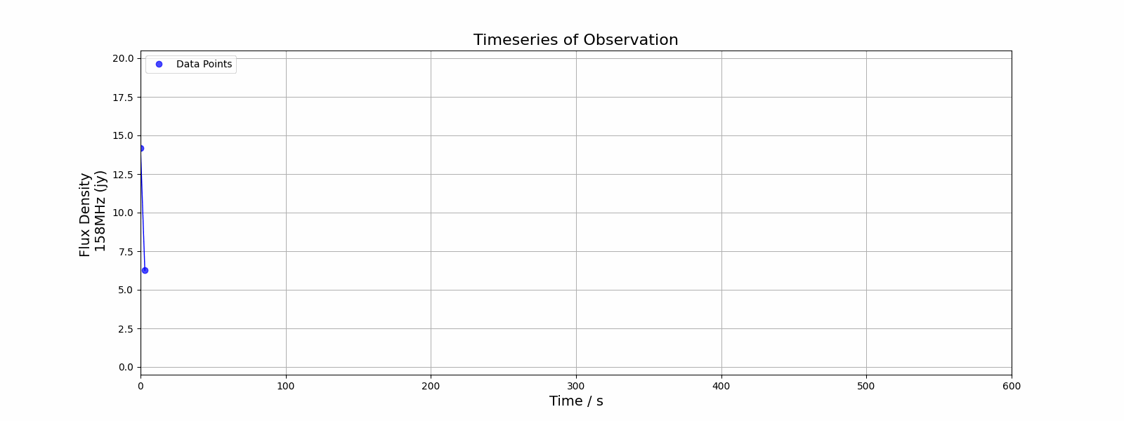
What is Interplanetary Scintillation (IPS)?
What we already know…
(Jy)
Morgan et al. (2018)

Slide 4
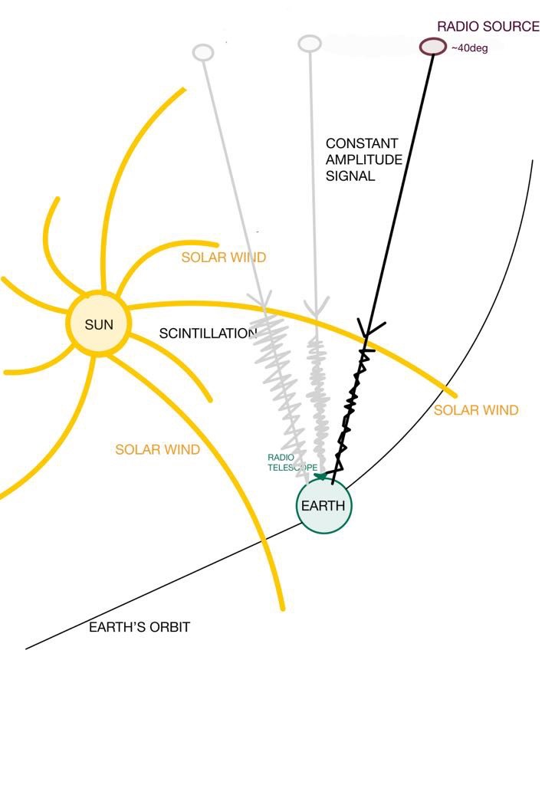
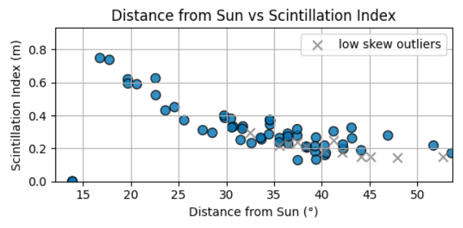
Measuring Space Weather
What we already know…
Morgan et al. (2018)

Slide 5
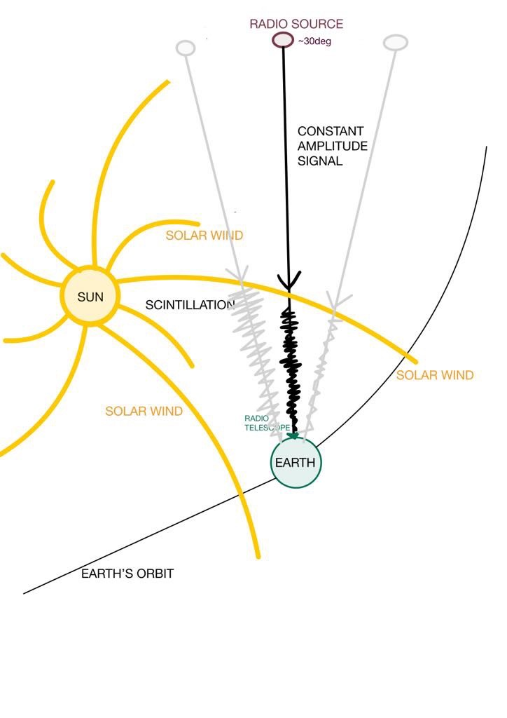
Measuring Space Weather
What we already know…
Morgan et al. (2018)

Slide 6
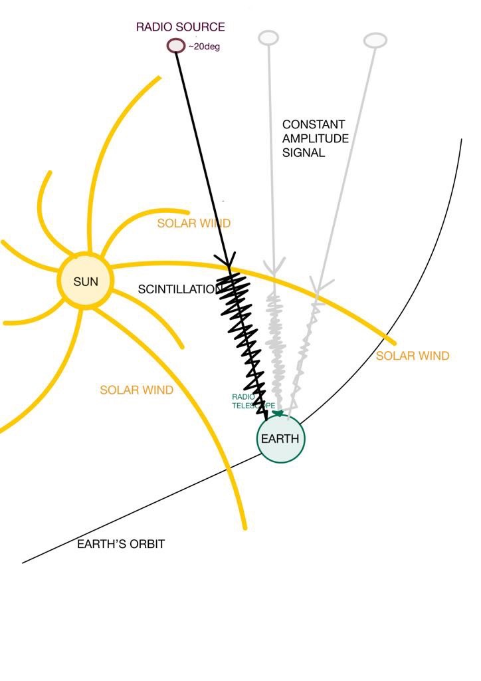
Measuring Space Weather
What we already know…
Morgan et al. (2018)

Slide 7
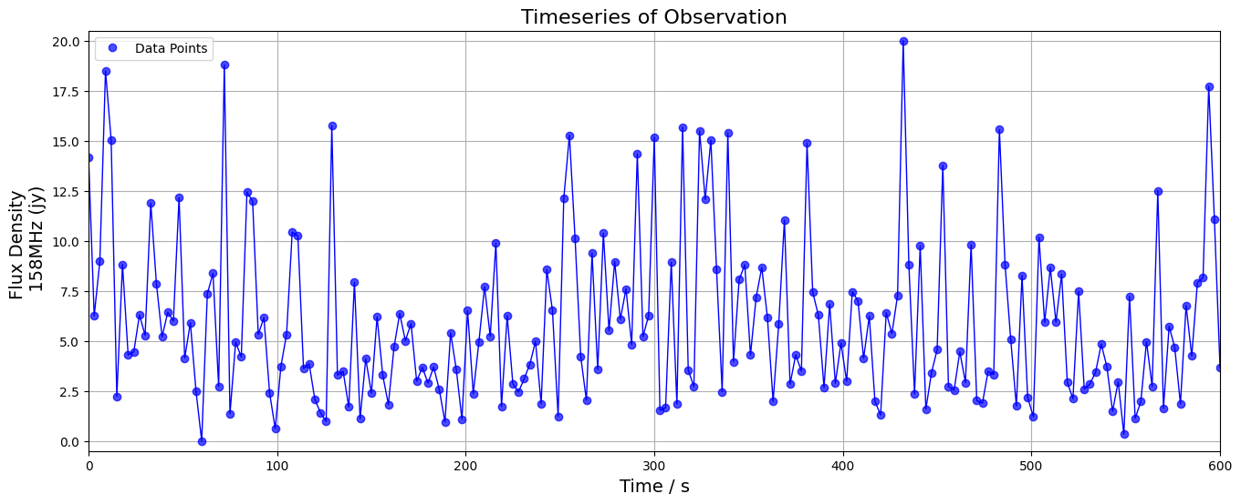
How do we measure Interplanetary Scintillation (IPS)?
What we already know…
IPS is measured by
NSI
'Normalised Scintillation Index'​
NSI is the normalised variation in flux of a radio source over time

Slide 8
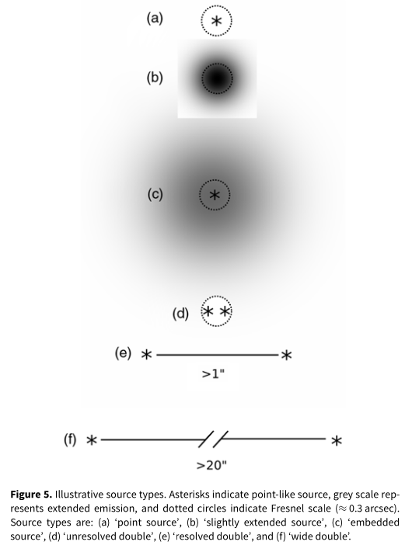
Compactness of a Source
What we already know…
NSI can be used to determine how compact a radio source is
Compact (1 NSI)
"Extended" (~0.5 NSI)
Credit:
Morgan et al. (2018)

Slide 9

My Project: To explore a new value that can be an alternative to NSI that may give us further insight into Interplanetary Scintillation (IPS)

Slide 10
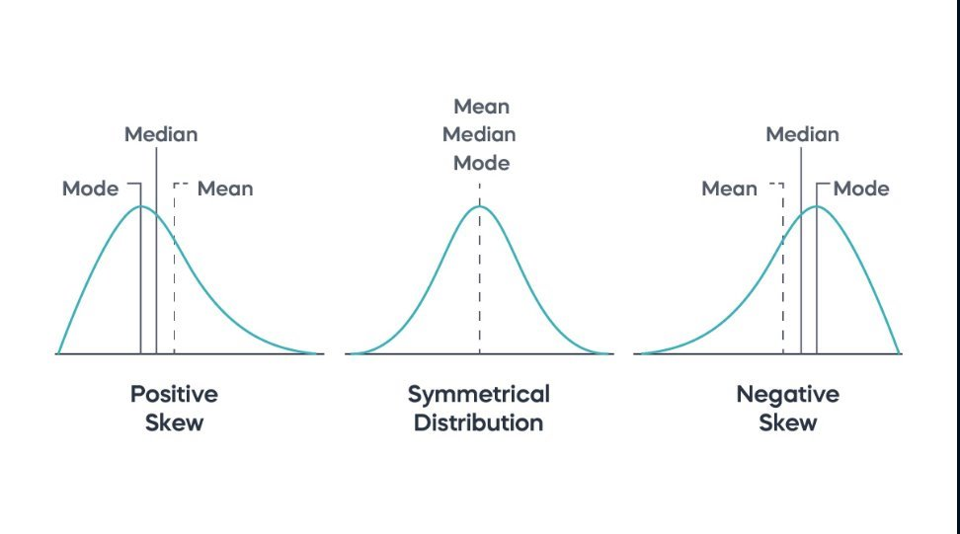
New value: Skewness?
Skewness measures the asymmetry of a
probability distribution

Slide 11
Probability Distribution of an Observation
Each observation is a 600 second timeseries of scintillating signal.
(Jy)

Slide 12
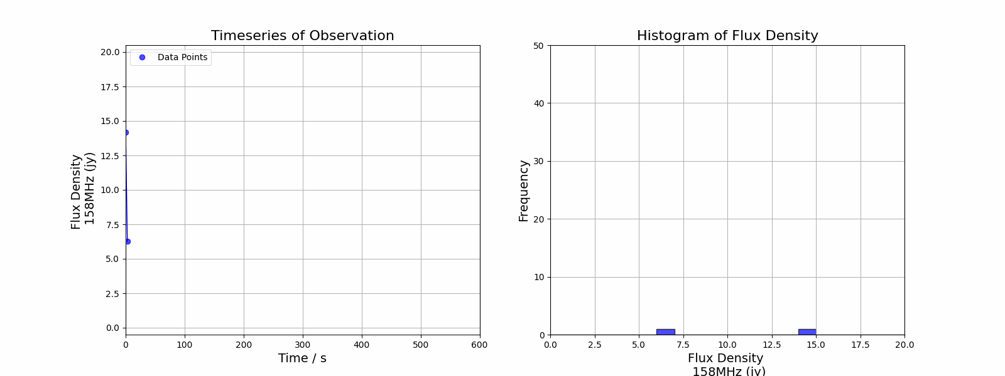
Probability Distribution of an Observation
Each Observation is a 600 second timeseries of scintillating signal.
(Jy)
(Jy)

Slide 13
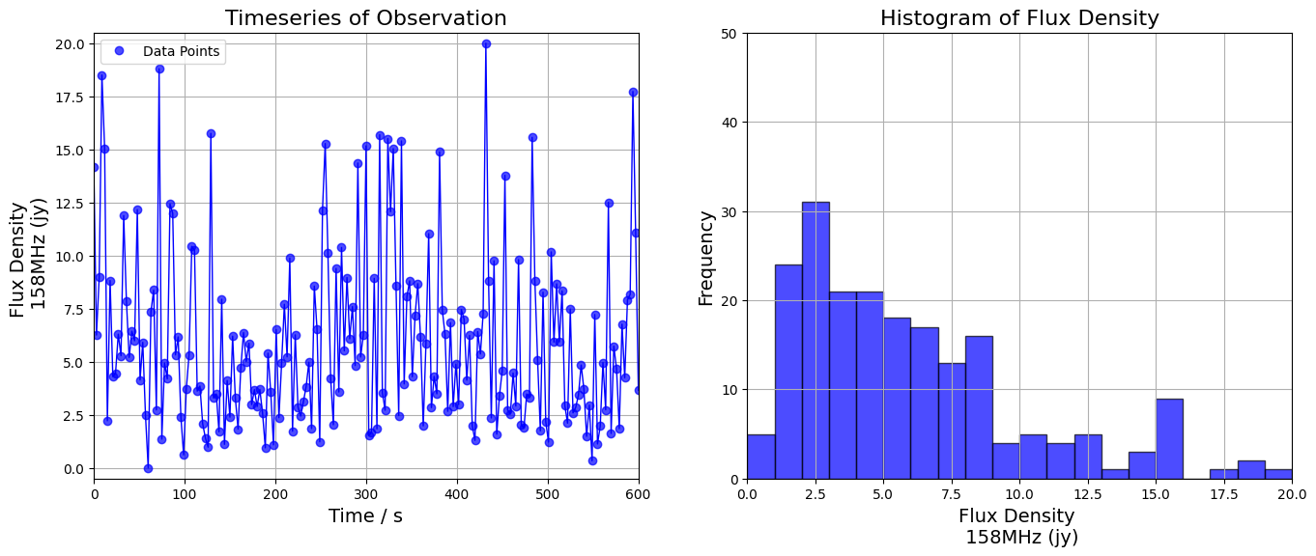
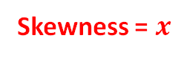
Skewness of a Probability Distribution
Skewness = $x$
(Jy)
Notes:
Remember back to Stats 101? Skewness measures the asymmetry of a probability distribution;
a positive skew means a longer right tail,
a negative skew means a longer left tail,
and zero skew indicates a symmetric distribution.

Slide 14
Can Skewness be a useful measure?
Q1: Could it be useful to determine the compactness of radio sources?
Q2: Can it be useful to measure Space Weather?
Q3: Can skewness serve as a viable alternative to the scintillation index for single-dish telescopes, unlike arrays like the Murchinson Widefield Array?

Slide 15
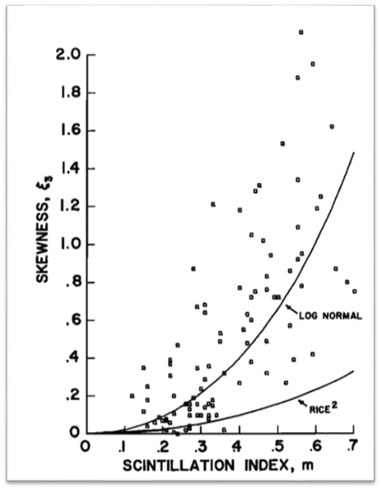
Skewness has been explored before
Armstrong, Coles & Rickett, 1972:
Plotted a single source (the Crab Pulsar) of Skewness vs Scintillation Index
Found a relationship between Scintillation and Skewness
Fits a lognormal curve
2025: Why should I revisit this?
Access to ~800 radio sources & 20,000+ individual observations (GLEAM)
Armstrong et al. (1972)

Slide 16
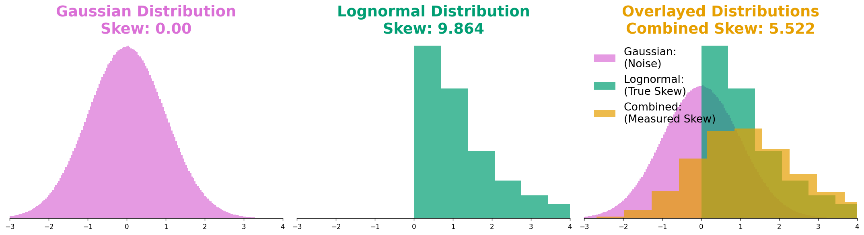
Find True Skew by removing noise
Used Monte Carlo to create Combined Distributions of different Signal (Lognormal) to Noise (Gaussian) Ratios

Slide 17
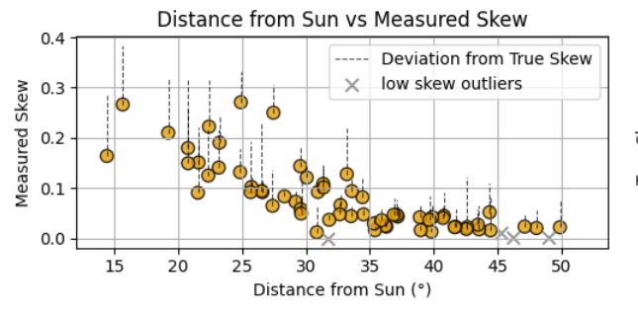
Find True Skew
Used Monte Carlo to create Combined Distributions of different Signal (Lognormal) to Noise (Gaussian) Ratios
Calculated 'Measured Skew' of each Radio Source Observation's Scintillating timeseries

Slide 18
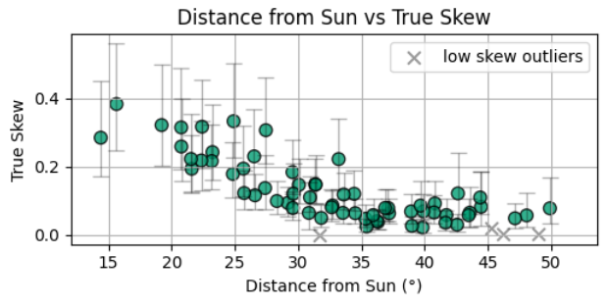
Find True Skew
Used Monte Carlo to create Combined Distributions of different Signal (Lognormal) to Noise (Gaussian) Ratios
Calculated 'Measured Skew' of each Radio Source Observation's Scintillating timeseries
Deconvolved the Combined shaped 'Measured Skew' from the Gaussian shaped noise (depending on Observations' Signal to Noise) to find Lognormal Shaped True Skew – for each Observation

Slide 19
Find True Skew
Used Monte Carlo to create Combined Distributions of different Signal (Lognormal) to Noise (Gaussian) Ratios
Calculated 'Measured Skew' of each Radio Source Observation's Scintillating timeseries
Deconvolved the Combined shaped 'Measured Skew' from the Gaussian shaped noise (depending on Observation’s Signal to Noise) to find Lognormal Shaped True Skew – for each Observation
Determined 1 sigma confidence intervals for each observation to show the variability associated with each True Skew result

Slide 20
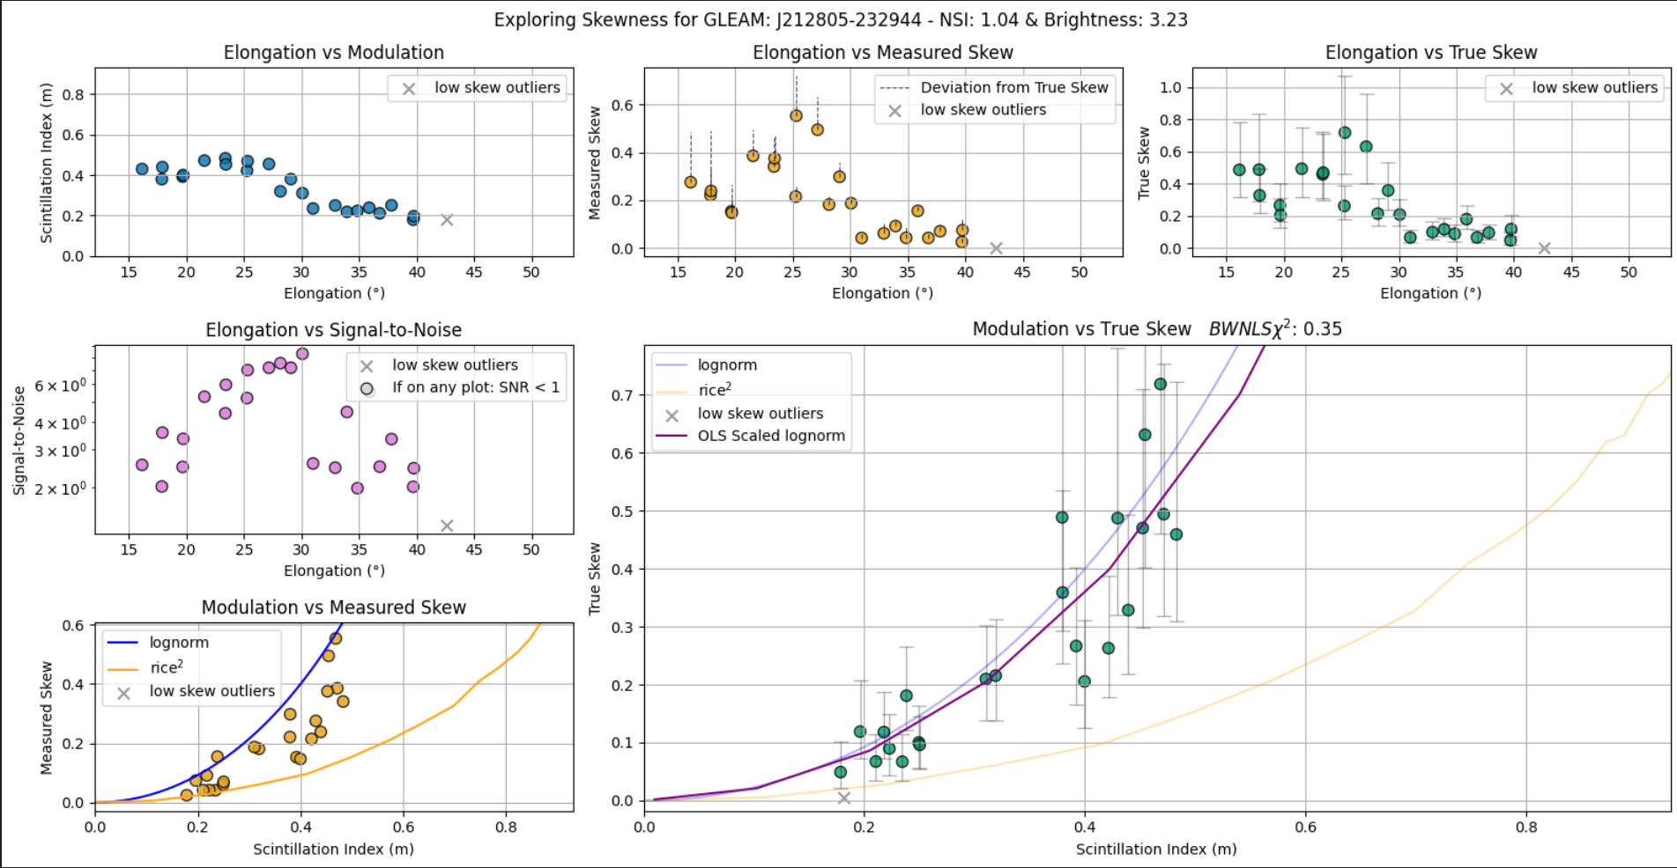
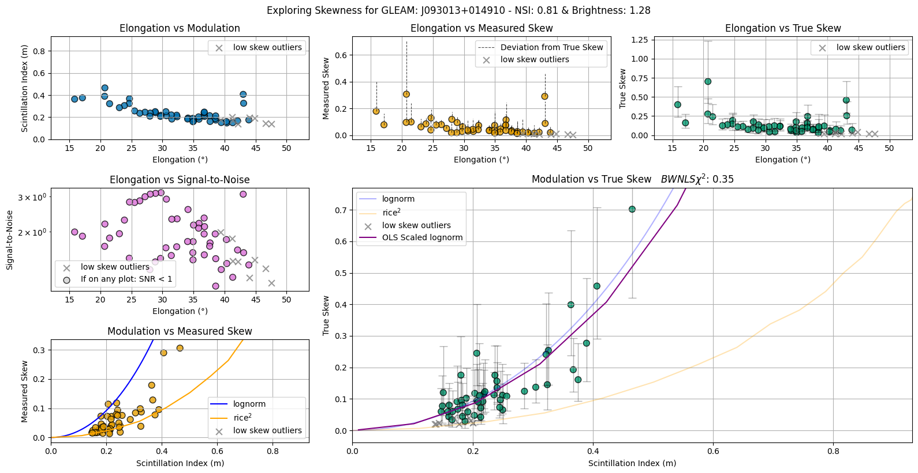
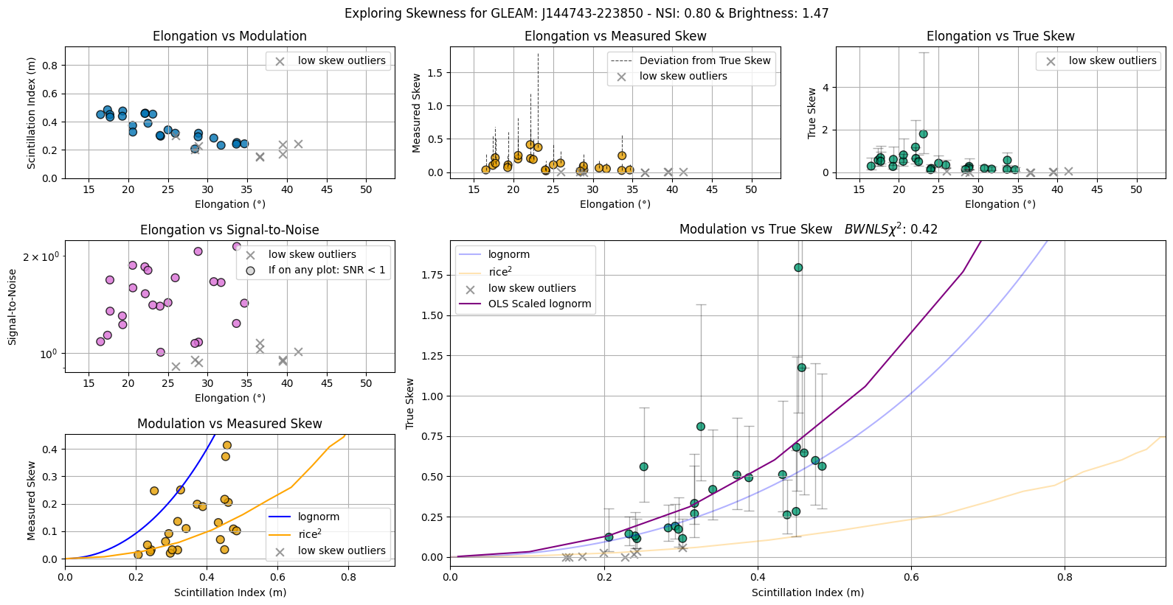
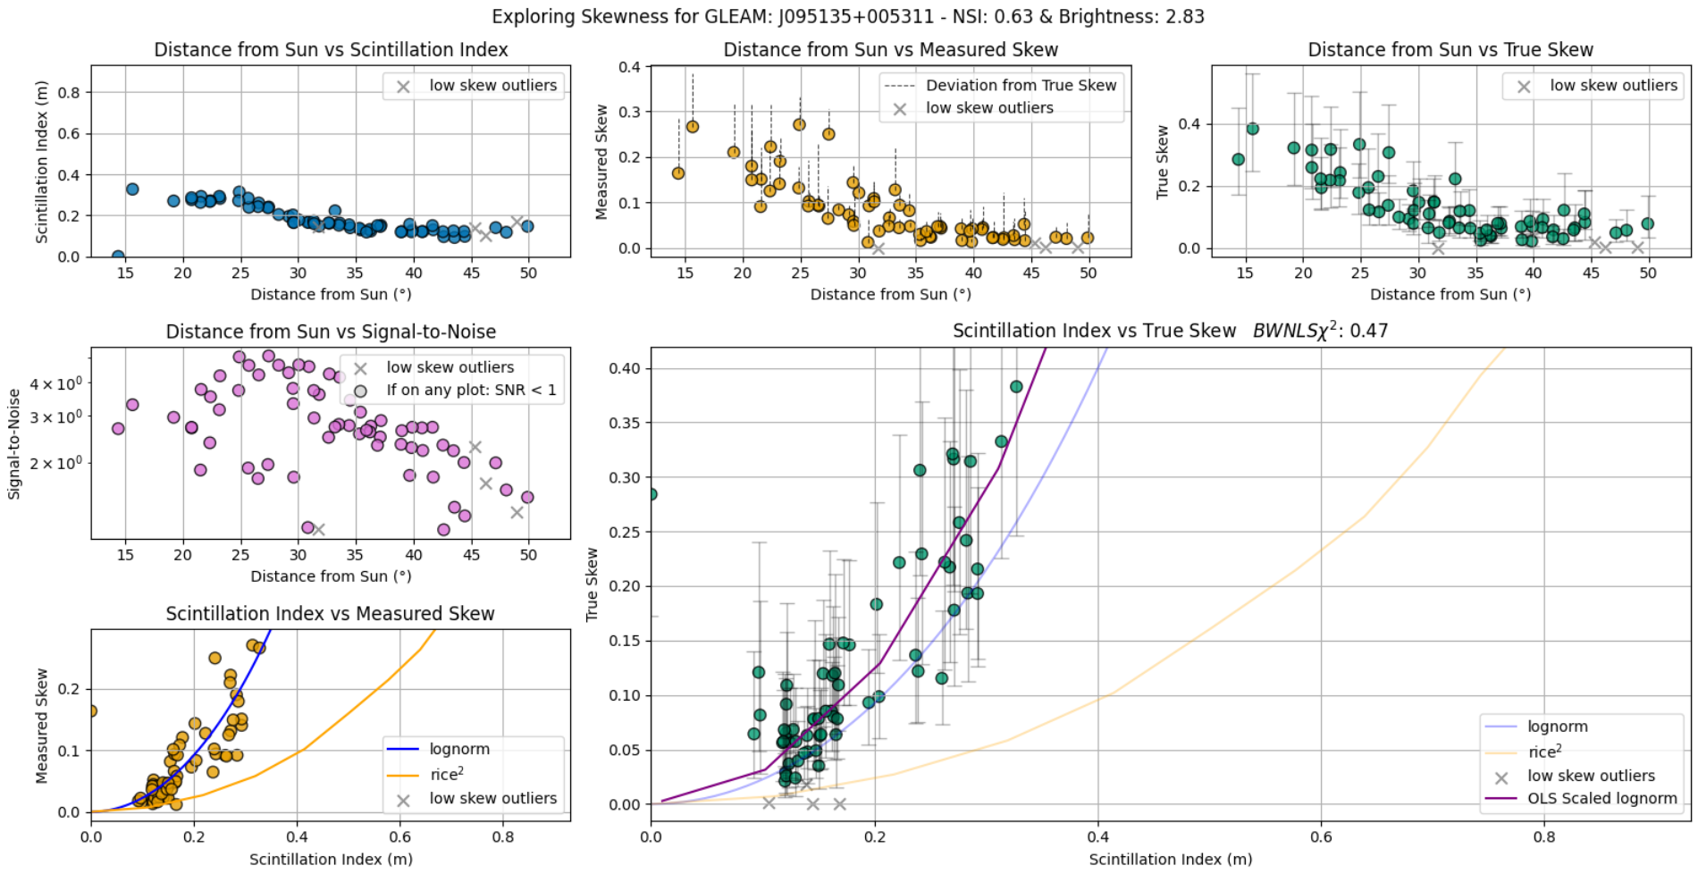
Made lots of plots!

Slide 21
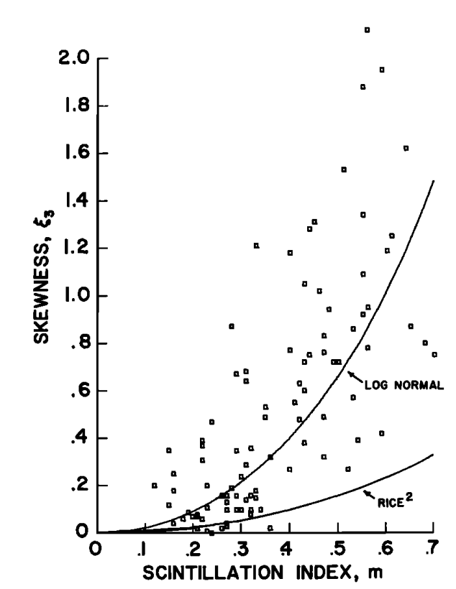
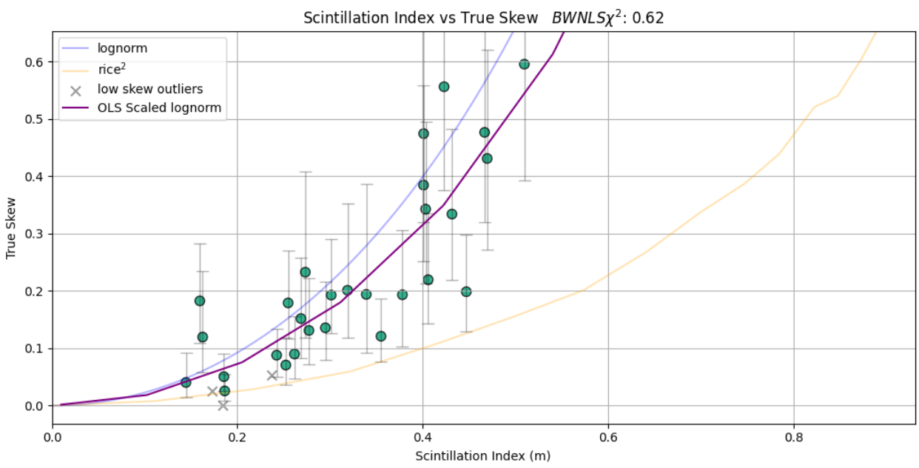
Armstrong et al. 1972 and me, 2025
Armstrong et al. (1972)

Slide 22
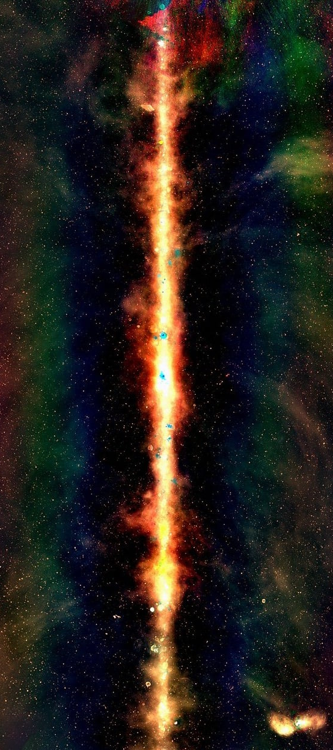
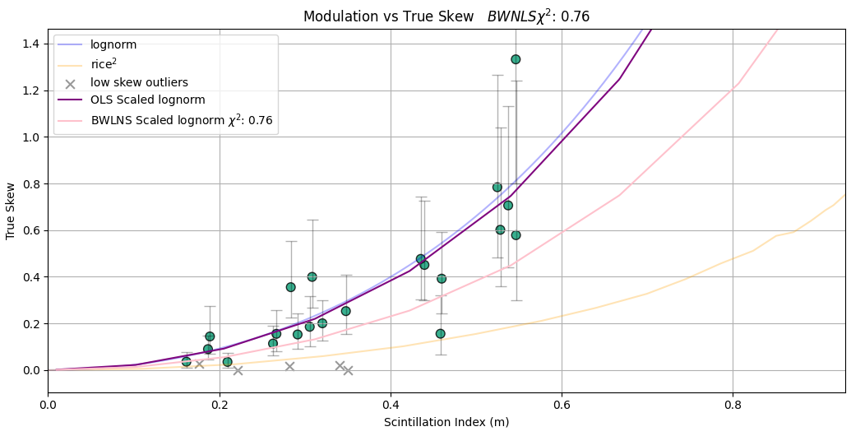
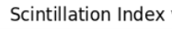
Fitted a sliding model or two...
Fitted two sliding scale Lognormal curve models to each source:
Purple Model using Ordinary Least Squares
Purple Model

Slide 23
Fitted a sliding model or two...
Fitted two sliding scale Lognormal curve models to each source:
Purple Model using Ordinary Least Squares
Pink Model using "Barlow’s Weighted Non-linear Least Squares" for:
Asymmetric Errors
Greater weights for observations with less variability (higher confidence)
Pink Model

Slide 24
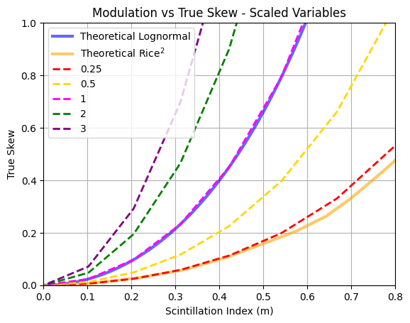
Fitted a sliding model or two...
Fitted two sliding scale Lognormal curve models to each source:
Each sliding curve outputs a Scaled Variable value (how far does it vary from the theoretical lognormal)

Slide 25
Q1: Can Skewness determine compactness of radio sources?

Slide 26
Q1: Can Skewness determine compactness of radio sources?
If we can show a relationship between the Skewness Scaled Variable and NSI for all radio sources, then we can use either one as a measure for compactness!
Compact (1 NSI)
(Skew SV: ?)
"Extended"
(~0.5 NSI)
(Skew SV: ?)
Credit:
Morgan et al. (2018)

Slide 27
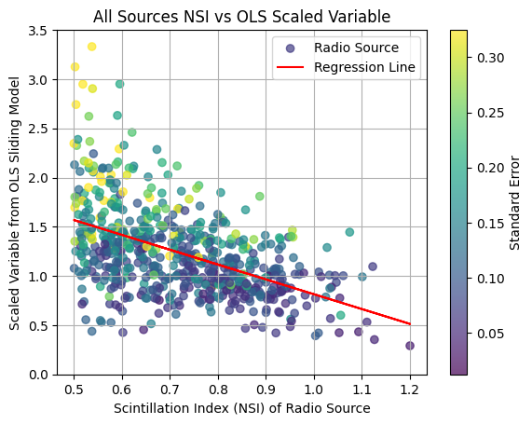
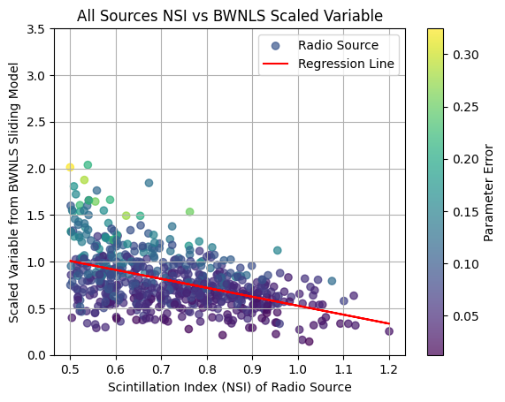
Q1: Can Skewness determine compactness of radio sources?
Stronger relationship between existing and proposed measure due to less spread and errors
Purple Model
Pink Model
So if NSI can measure compactness then Skewness can too!

Slide 28
Q2: Can Skewness measure Space Weather?

Slide 29
Q2: Can Skewness measure Space Weather?
...sometimes

Slide 30
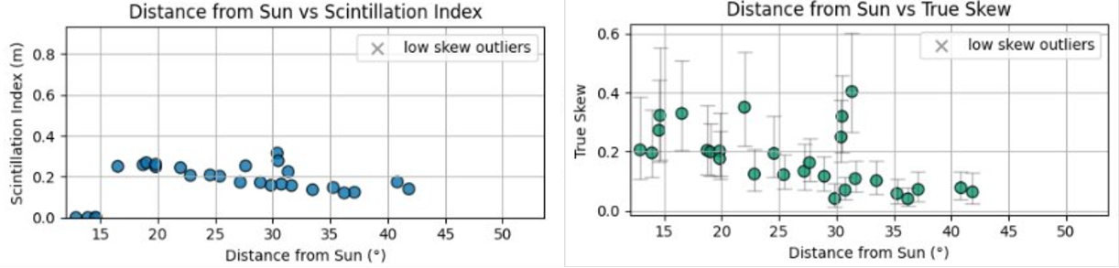

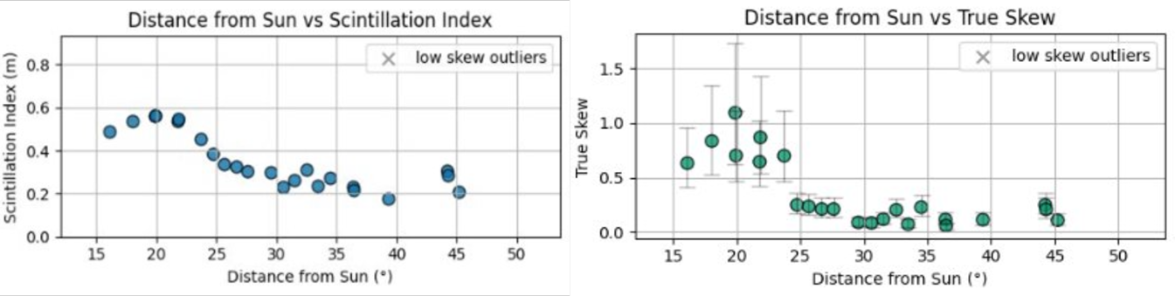

Q2: Can Skewness measure Space Weather?
….sometimes
Example:
Skewness is not affected when Scintillation Index readings fail
(common when close to the sun)
Example:
Error bars True Skew are big

Slide 31
Q3: Can Skewness be used as an equivalent alternative to Scintillation Index for single dish telescopes (unlike the MWA)?

Slide 32

Thank you to the S&A team!
Especially thank you to my Supervisor, Dr John Morgan & those who made the Internship program possible!
Saf Flatters Bachelor of Science (Data Science, Geospatial, AI)
MWAtelescope.org

